Slide 1
Cloud Computing
By: Russell Gehan, Jonathan Bui, Paul Edwards

Slide 2
Infrastructure as a Service
Infrastructure as a Service (Iaas) is the most cost-efficient Cloud Computing Service for customers in need of a temporary platform that supplies virtualization, servers, storage, and networking. Customers can rent these infrastructures, which are scalable in size and complexity, on demand and only as long they need them. Iaas is also fast and easy to operate without requiring customers with the need to manage or support the underlying infrastructure.
Notes:
1. Explain your understanding of the three different types of Services.

Slide 3
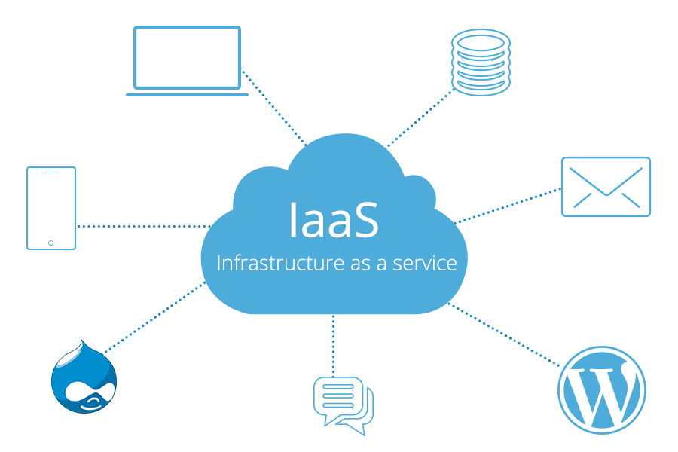
IaaS Example
A small pizzeria may prefer Iaas to manage a small database that is likely to grow over time and keeps track of their customers, menu, and orders.
That’s when distributed computing with Azure, AWS, GCE, etc becomes useful.
A Public Cloud would be best in this scenario because the DB would be managed by the Iaas provider, which allows the business to access their resources through a browser.
Notes:
4. Explain which type of cloud (private, public, hybrid) is best for each situation.

Slide 4
Platform as a Service
Includes all services provided by IaaS including data storage, processing and security.
Also provides additional usually development related services
Ex. Runtime, logging, monitoring/analytics
Notes:
2. Give at least 1 example of a real-life situation using each type of service.

Slide 5
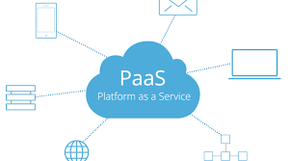
PaaS Example
Open source dev team deploying a website on Heroku, Azure, AWS S3
Public Cloud

Slide 6
Software as a Service
SaaS is a premium service that is oriented towards the manufacturing and accomplishment of software and development across the interweb. With this structure, the host of the cloud server also manages the software application, maintenance, upgrades, security, and infrastructure. The roles of the user with SaaS is simply to connect to the application and access its features.
Notes:
3. Explain WHY that service is best for each situation.

Slide 7
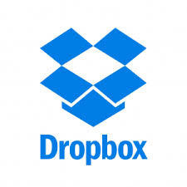
SaaS Example
Sending files to someone, or multiple people, but Gmail/random email service hates you/your file types/your file size.
Solution: Dropbox
This is best run as a public cloud, because with private or hybrid, it would require your host computer to be online. Best to have everything taken care of on the server’s end. Also allows for long distance sharing more easily, because it does not rely on a single companies connections.
A guess of an Azure example would be the Web Applications that we created yesterday.
They are held up by the server, and don’t require our computer. The user can just use it, and it interacts with the database.

Slide 8
Sources
Mark’s Powerpoint - ../trainer-code/REPO_MarksCodeAndPPTs/DotNetPPTs/dotnetWeek4Ppts/D20_.NET_CloudComputingBasicsAndModels
DropBox picture - https://tinyurl.com/vxsc9ug

